Slide 1

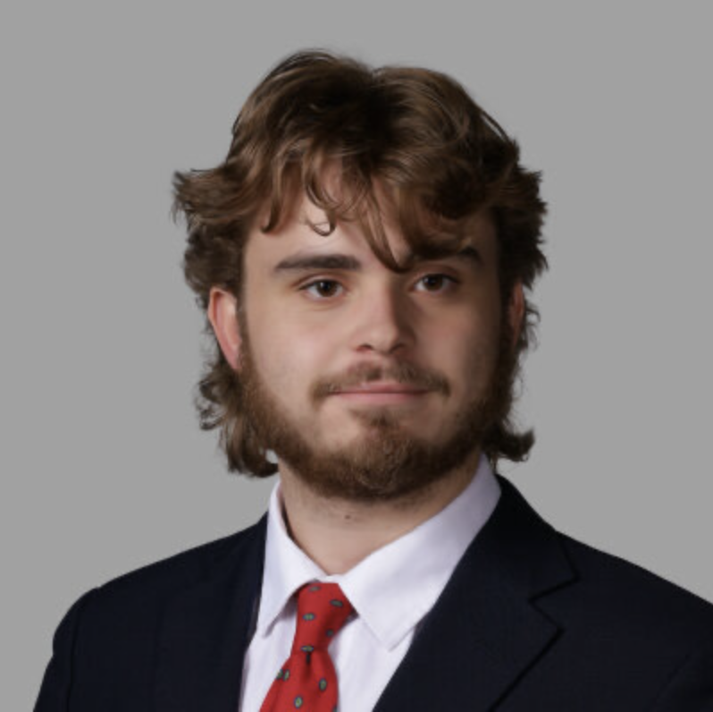
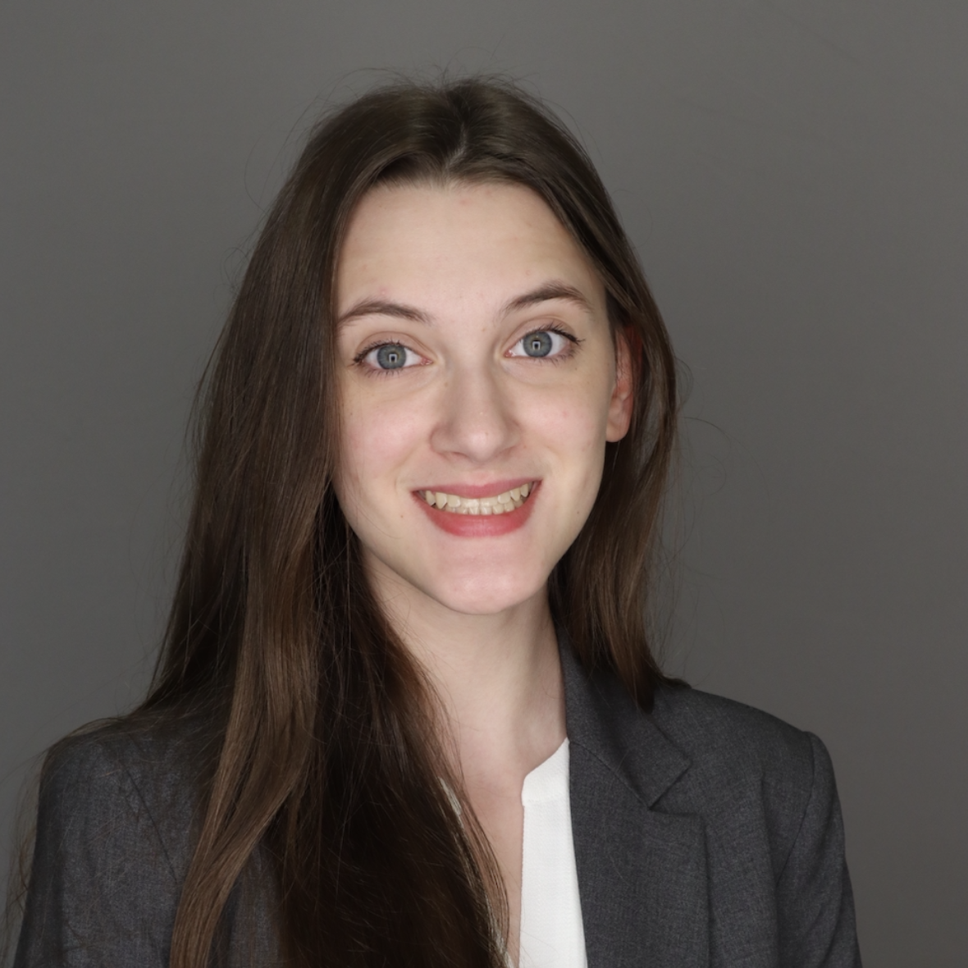
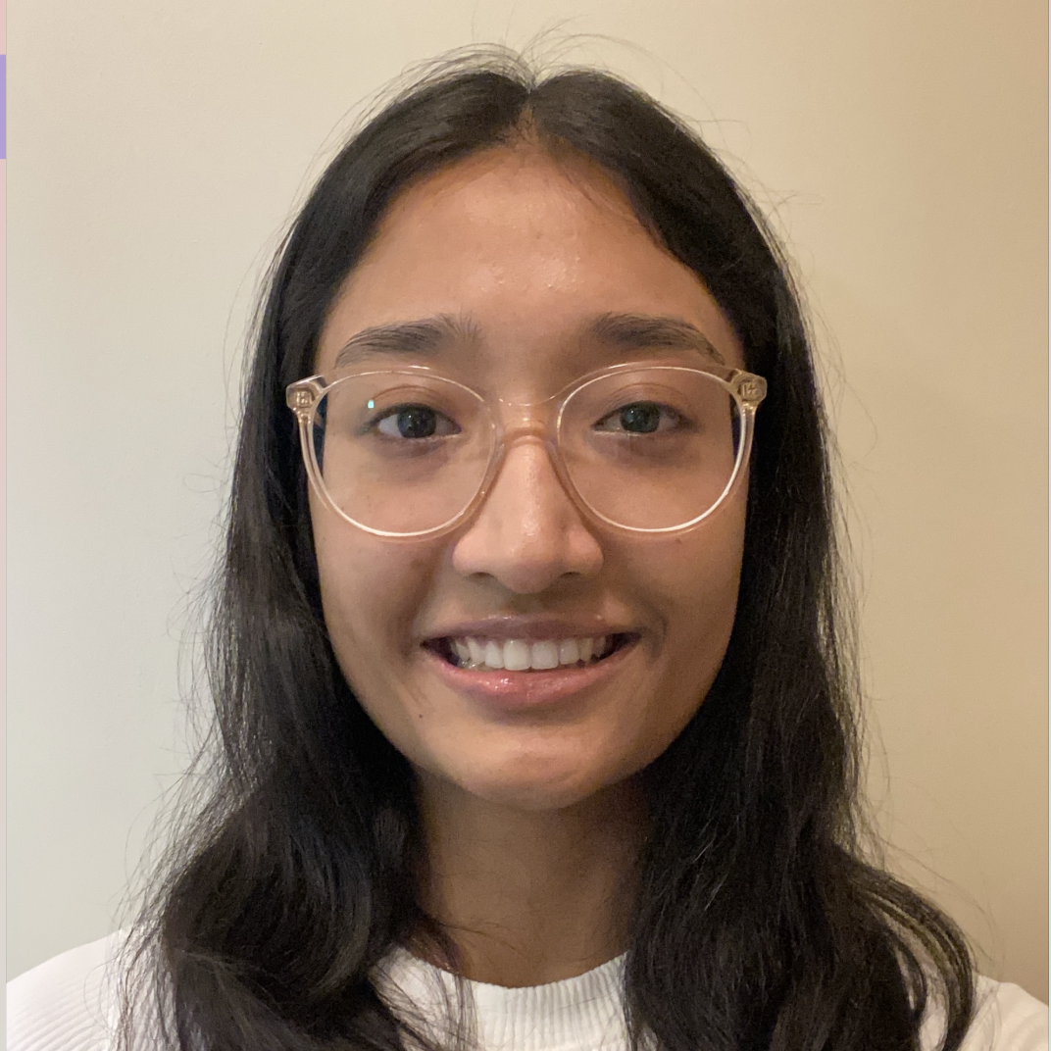
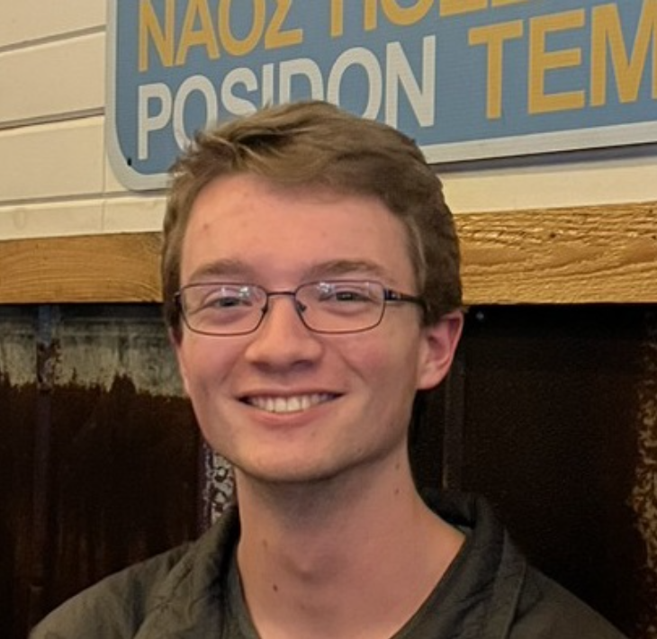

Mentor management system
Andrew Hahn
Hannah Hazelwood
Manjila Singh
Gregory Nothnagel
Source code: https://github.com/manjilasingh/mentor-management-system
Cloud Hosted Website: https://10.8.0.56:3000 Project website: https://mentor-management-system-cs495.github.io/
Notes:
https://mentor-management-system-cs495.github.io/

Slide 2


Project OVERVIEW
CS department needs a mentorship program
20-25 mentors, 1100 students
Facilitate interaction through web app
Enhance networking, confidence, and growth for students
Enhance leadership, personal fulfillment, and networking for mentors

Slide 3
Functionality Implemented
We successfully implemented all the functionality which was initially planned
Login
Mentor-student tracking
Meeting log
Profiles
Admin panel
DB backup
DB CSV upload
View all/my students/mentors
Serve website via server

Slide 4
Significant Backlog Items
Batch updates to student-mentor assignments
1
Automate testing
2
Add student workers or TAs as admins
3
Add cohort tracking
4

Slide 5
Demo time
Website: https://10.8.0.56:3000/ (frontend)
https://10.8.0.56:8000/admin/ (admin dashboard)
CSVs on next slide
Notes:
Andy: mentor, profile?
Hannah: meeting log, admin panel
Manjila: CSV upload, meet-my-mentor
Gregory: request mentor change, OAuth login, database backup
Order: Oauth login, login as student (show meet my mentor, request mentor change, meeting log, student profile), show admin panel (csv upload (new error handling)), change to mentor, login as mentor (my students), database backup
(google cloud server link (in case of intranet server issues): https://34.170.92.44:8000/admin/ )

Slide 6
Demo CSV
Null: https://bama365-my.sharepoint.com/:x:/g/personal/hrhazelwood_crimson_ua_edu/Ec-MASjz-ONBhzeC2R4Ipw4BX_vz9dTJHh8RJM1UPFkeNw?e=q3PCby
Incorrect: https://bama365-my.sharepoint.com/:x:/g/personal/hrhazelwood_crimson_ua_edu/EUQcfAEwgG1FqjE__TCUqSwBUOxed6ClR4rgWGRZ_p32vA
Correct: https://bama365-my.sharepoint.com/:x:/g/personal/hrhazelwood_crimson_ua_edu/EX2FFJlG3npAuSqIgbo1eAABf8qsqVbfqXsb6jpVlOXLAQ?e=Neb0vT
Notes:
Andy: mentor, profile?
Hannah: meeting log, admin panel
Manjila: CSV upload, meet-my-mentor
Gregory: request mentor change, OAuth login, database backup
Order: Oauth login, login as student (show meet my mentor, request mentor change, meeting log, student profile), show admin panel (csv upload (new error handling)), change to mentor, login as mentor (my students), database backup
(google cloud server link (in case of intranet server issues): https://34.170.92.44:8000/admin/ )

Slide 7
Demo Video (in case of issue with live demo):
https://alabama.box.com/s/b2eng3by1ju9zgk4uu8jovvo5cngw8ik

Slide 8
Significant Backlog Items
Batch updates to student-mentor assignments
Automate testing
Add student workers or TAs as admins
Add cohort tracking

